Slide 1

Name of the School: School of computer science and engineering
Course Code: OOP Course Name: E2UC201
Topic: Inheritance and Exception Handling
Faculty Name: Rahul Anjana Programe Name: B.Tech

Slide 2
Objectives
Learn about Inheritance in Object Oriented Programming.
Underscore the importance of inheritance and its various types.
Learn to implement inheritance through a python program.
Understand Method Overriding and super() functions in the world of Object Oriented Programming.
Understand what exceptions are.
Understand how to use try / except blocks to catch exceptions
Understand how to raise exceptions.

Slide 3
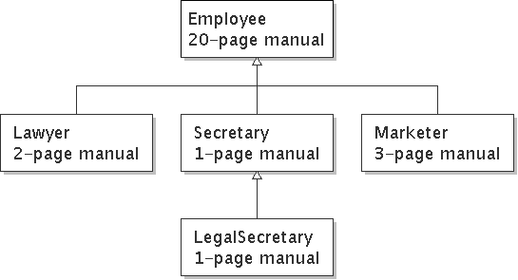
Introduction
Inheritance: Forming new classes based on existing ones.
a way to share/reuse code between two or more classes
superclass: Parent class being extended.
subclass: Child class that inherits behavior from superclass.
gets a copy of every field and method from superclass
is-a relationship: Each object of the subclass also "is a(n)" object of the superclass and can be treated as one.

Slide 4
Continue…
Inheritance: An element of OOP that allows a new class to be based on an existing one where the new automatically gets (or inherits) all of the methods and attributes of the existing class
The children classes get all the capabilities (methods) and properties (attributes) the parent class has; the children classes are also called derived classes
Get the code for free! (code-reuse) – inheritance allows a new class to re-use code which already existed in another class (the parent class)

Slide 5
Continue…
To create specializations of existing classes or objects by adding new attributes and methods!
often called subtyping when applied to classes. In specialization, the new class or object has data or behavior aspects that are not part of the inherited class.
Over-ridding (e.g., over-ridding of the + operator, so + has different meaning, addition of two numbers, concatenation of two strings, etc) – the same method that does something different

Slide 6
Altering the Behavior of Inherited Methods: Overriding
Override: To redefine how inherited method of base class works in derived class
Two choices when overriding
Completely new functionality vs. overridden method
Incorporate functionality of overridden method, add more

Slide 7
Understanding Polymorphism
Polymorphism: Aspect of object-oriented programming that allows you to send same message to objects of different classes, related by inheritance, and achieve different but appropriate results for each object

Slide 8
OBJECT and CLASS

Slide 9
Object
Everything in Python is really an object.
“hello”.upper() list3.append(‘a’) dict2.keys()
These look like Java or C++ method calls.

Slide 10
Continue
New object classes can easily be defined in addition to these built-in data-types.
In fact, programming in Python is typically done in an object oriented fashion.

Slide 11
Class
A class is a special data type which defines how to build a certain kind of object.
The class also stores some data items that are shared by all the instances of this class.
Instances are objects that are created which follow the definition given inside of the class.

Slide 12
Continue…
Python doesn’t use separate class interface definitions as in some languages.
You just define the class and then use it

Slide 13
Methods in Classes
Define a method in a class by including function definitions within the scope of the class block.
There must be a special first argument self in all of method definitions which gets bound to the calling instance.
There is usually a special method called __init__ in most classes.

Slide 14
A simple class def: student
class student: “““A class representing a student ”””
def __init__(self,n,a): self.full_name = n self.age = a def get_age(self): return self.age

Slide 15
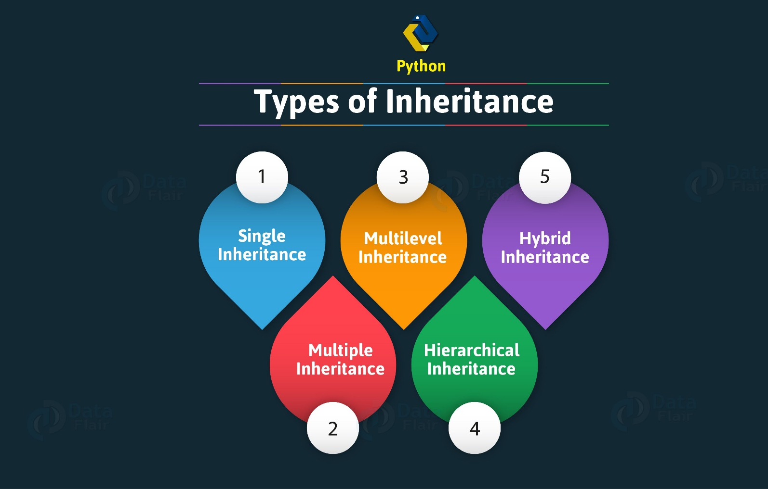
Types of Inheritance

Slide 16
Continue…
Python Single Inheritance
A single Python inheritance is when a single class inherits from a class.
Python Multiple Inheritance
Multiple Python inheritance are when multiple python classes inherit from a class.
Python Multilevel Inheritance When one class inherits from another, which in turn inherits from another, it is multilevel python inheritance.

Slide 17
Continue…
Python Hierarichal Inheritance
A base class inherited by more than one derive class.
Python Hybrid Inheritance
This Inheritance is combination of two or more than two inheritance..

Slide 18
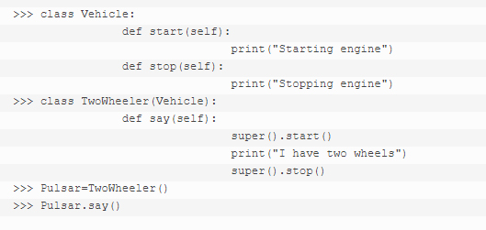
Python Inheritance Super Function – Super()
With inheritance, the super() function in python actually comes in quite handy. It allows us to call a method from the parent class. Let’s define a new class for this.

Slide 19
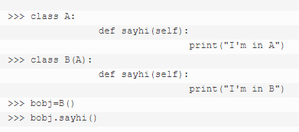
Python override method
A subclass may change the functionality of a Python method in the superclass. It does so by redefining it. This is termed python method overriding. Lets see this Python Method Overriding Example.

Slide 20
Abstraction
Suppose you booked a movie ticket from bookmyshow using net banking or any other process. You don’t know the procedure of how the pin is generated or how the verification is done. This is called ‘abstraction’ from the programming aspect, It basically means you only show the implementation details of a particular process and hide the details from the user.

Slide 21
Exceptions Handling
Python provides two very important features to handle any unexpected error in your Python programs and to add debugging capabilities in them:
Exception Handling
Assertions

Slide 22
What is Exception
An exception is an event, which occurs during the execution of a program, that disrupts the normal flow of the program's instructions.
In general, when a Python script encounters a situation that it can't cope with, it raises an exception. An exception is a Python object that represents an error.
When a Python script raises an exception, it must either handle the exception immediately otherwise it would terminate and come out.

Slide 23
Handling an exception
If you have some suspicious code that may raise an exception, you can defend your program by placing the suspicious code in a try: block. After the try: block, include an except: statement, followed by a block of code which handles the problem as elegantly as possible.
Syntax:
try:
You do your operations here;
......................
except Exception I:
If there is ExceptionI, then execute this block.
except Exception II:
If there is ExceptionII, then execute this block.
......................
else:
If there is no exception then execute this block.

Slide 24
Continue…
Here are few important points in mentioned syntax:
A single try statement can have multiple except statements. This is useful when the try block contains statements that may throw different types of exceptions.
You can also provide a generic except clause, which handles any exception.
After the except clause(s), you can include an else-clause. The code in the else-block executes if the code in the try: block does not raise an exception.
The else-block is a good place for code that does not need the try: block's protection.

Slide 25
Example
try:
fh = open("testfile", "w")
fh.write("This is my test file for exception handling!!")
except IOError: print "Error: can\'t find file or read data"
else: print "Written content in the file successfully"
fh.close()
This will produce following result:
Written content in the file successfully

Slide 26
The except clause with no exceptions
You can also use the except statement with no exceptions defined as follows:
try:
You do your operations here;
......................
except:
If there is any exception, then execute this block. ......................
else:
If there is no exception then execute this block.

Slide 27
Continue…
This kind of a try-except statement catches all the exceptions that occur. Using this kind of try-except statement is not considered a good programming practice, though, because it catches all exceptions but does not make the programmer identify the root cause of the problem that may occur.

Slide 28
Multiple Exceptions
The except clause with multiple exceptions:
You can also use the same except statement to handle multiple exceptions as follows:
try:
You do your operations here;
......................
except(Exception1[, Exception2[,...ExceptionN]]]):
If there is any exception from the given exception list, then execute this block
.......................
else:
If there is no exception then execute this block.

Slide 29
The try-finally clause
You can use a finally: block along with a try: block. The finally block is a place to put any code that must execute, whether the try-block raised an exception or not. The syntax of the try-finally statement is this:
try:
You do your operations here;
......................
Due to any exception, this may be skipped.
finally:
This would always be executed.
......................
Note that you can provide except clause(s), or a finally clause, but not both. You can not use else clause as well along with a finally clause.

Slide 30
Example
try:
fh = open("testfile", "w")
fh.write("This is my test file for exception handling!!")
finally:
print "Error: can\'t find file or read data"
If you do not have permission to open the file in writing mode then this will produce following result:
Error: can't find file or read data

Slide 31
Argument of an Exception
An exception can have an argument, which is a value that gives additional information about the problem. The contents of the argument vary by exception. You capture an exception's argument by supplying a variable in the except clause as follows:
try:
You do your operations here;
......................
except ExceptionType, Argument:
You can print value of Argument here...

Slide 32
Continue…
If you are writing the code to handle a single exception, you can have a variable follow the name of the exception in the except statement. If you are trapping multiple exceptions, you can have a variable follow the tuple of the exception.
This variable will receive the value of the exception mostly containing the cause of the exception. The variable can receive a single value or multiple values in the form of a tuple. This tuple usually contains the error string, the error number, and an error location.

Slide 33
Example
Following is an example for a single exception:
def temp_convert(var):
try:
return int(var)
except ValueError, Argument:
print "The argument does not contain numbers\n", Argument
temp_convert("xyz");
This would produce following result:
The argument does not contain numbers
invalid literal for int() with base 10: 'xyz'

Slide 34
Raising an exceptions
You can raise exceptions in several ways by using the raise statement. The general syntax for the raise statement.
Syntax:
raise [Exception [, args [, traceback]]]
Here Exception is the type of exception (for example, NameError) and argument is a value for the exception argument. The argument is optional; if not supplied, the exception argument is None.
The final argument, traceback, is also optional (and rarely used in practice), and, if present, is the traceback object used for the exception

Slide 35
Example
def functionName( level ):
if level < 1:
raise "Invalid level!", level
# The code below to this would not be executed
# if we raise the exception

Slide 36
Continue…
Note: In order to catch an exception, an "except" clause must refer to the same exception thrown either class object or simple string. For example to capture above exception we must write our except clause as follows:
try:
Business Logic here...
except "Invalid level!":
Exception handling here...
else:
Rest of the code here...

Slide 37
User-Defined Exceptions
Python also allows you to create your own exceptions by deriving classes from the standard built-in exceptions.
Here is an example related to RuntimeError. Here a class is created that is subclassed from RuntimeError. This is useful when you need to display more specific information when an exception is caught.
In the try block, the user-defined exception is raised and caught in the except block. The variable e is used to create an instance of the class Networkerror.

Slide 38
Example
class Networkerror(RuntimeError):
def __init__(self, arg):
self.args = arg
So once you defined above class, you can raise your exception as follows:
try:
raise Networkerror("Bad hostname")
except Networkerror,e:
print e.args

Slide 39
Practice Questions
1. Create a Class with instance attributes.
2. Create a Vehicle class without any variables and methods
3. Create a child class Bus that will inherit all of the variables and methods of the Vehicle class
4. Write a Python program to handle a ZeroDivisionError exception when dividing a number by zero.
5. When should you use assertions instead of try/except blocks.

Slide 40
References
https://en.wikipedia.org/wiki/Inheritance_(object-oriented_programming)
https://www.studytonight.com/python/types-of-inheritance
https://www.programiz.com/python-programming/inheritance
https://data-flair.training/blogs/python-inheritance/

